Slide 1
IMPLEMENTATION SUPPORT

Slide 2
ELEMENTS OF WINDOWING SYSTEMS
In earlier chapters, we have discussed the elements of the WIMP interface but only with respect to how they enhance the interaction with the end-user.
Here we will describe more details of windowing systems used to build the WIMP interface.
The first important feature of a windowing system is its ability to provide programmer independence from the specifics of the hardware devices.
A typical work station will involve some visual display screen, a keyboard and some pointing device, such as a mouse.
Any variety of these hardware devices can be used in any interactive system and they are all different in terms of the data they communicate and the commands that are used to instruct them.
To do this, the programmer wants to direct commands to an abstract terminal, which understands a more generic language and can be translated to the language of many other specific devices.

Slide 3
ELEMENTS OF WINDOWING SYSTEMS
Besides making the programming task easier, the abstract terminal makes portability of application programs possible.
Only one translation program or device driver needs to be written for a particular hardware device and then any application program can access it.
A given windowing system will have a fixed generic language for the abstract terminal which is called its imaging model.
The imaging models are sufficient to describe very arbitrary images.
In summary, we can see the role of a windowing system, depicted in Figure 8.1, as providing

Slide 4
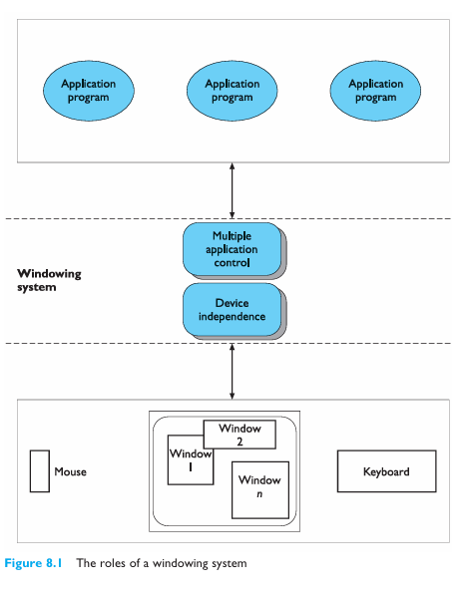
The role of a windowing system

Slide 5
Examples of imaging models
Pixels
The display screen is represented as a series of columns and rows of points or pixels which can be explicitly turned on or off, or given a color.
This is a common imaging model for personal computers and is also used by the X windowing system.
Graphical kernel system (GKS)
An international standard which models the screen as a collection of connected segments, each of which is a macro of elementary graphics commands.
Programmer’s hierarchical interface to graphics (PHIGS)
Another international standard, based on GKS but with an extension to model the screen as editable segments.
PostScript
A programming language developed by Adobe Corporation which models the screen as a collection of paths which serve as infinitely thin boundaries or stencils which can be filled in with various colors or textured patterns and images.

Slide 6
Architectures of windowing systems
Bass and Coutaz identify three possible architectures for the software to implement the roles of a windowing system.
All of them assume that device drivers are separate from the application programs.
The first option is to implement and replicate the management of the multiple processes within each of the separate applications.
This is not a very satisfactory architecture because it forces each application to consider the difficult problems of resolving synchronization conflicts with the shared hardware devices.
It also reduces the portability of the separate applications.
The second option is to implement the management role within the kernel of the operating system, centralizing the management task by freeing it from the individual applications.
Applications must still be developed with the specifics of the particular operating system in mind.

Slide 7
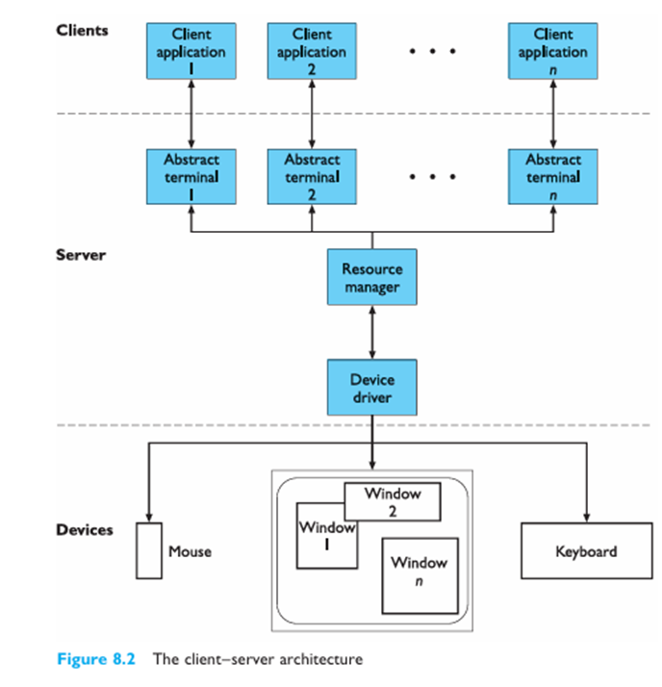
Architectures of windowing systems
The third option provides the most portability, as the management function is written as a separate application in its own right and so can provide an interface to other application programs that is generic across all operating systems.
This final option is referred to as the client–server architecture, and is depicted in Figure 8.2.

Slide 8
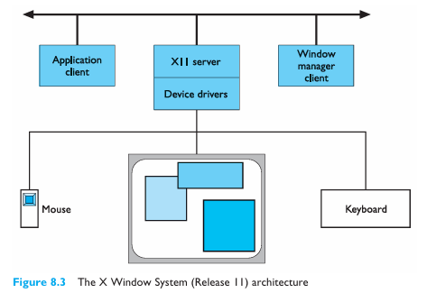
Architectures of windowing systems
In practice, the divide among these proposed architectures is not so clear and any actual interactive application or set of applications operating within a window system may share features with any one of these three conceptual architectures.
A classic example of a window system based on the client–server architecture is the industry-standard X Window System (Release 11), developed at the Massachusetts Institute of Technology (MIT) in the mid-1980s.

Slide 9
Architectures of windowing systems
The X Protocol can be implemented on different computers and operating systems, making X more device independent.
It also means that client and server need not even be on the same system in order to communicate to the server.
Each client of the X11 server is associated to an abstract terminal or main window. The X server performs the following tasks:
Allows (or denies) access to the display from multiple client applications;
Interprets requests from clients to perform screen operations or provide other information;
Demultiplexes the stream of physical input events from the user and passes them to the appropriate client;
Minimizes the traffic along the network by relieving the clients from having to keep track of certain display information, like fonts, in complex data structures that the clients can access by ID numbers.

Slide 10
PROGRAMMING THE APPLICATION
Interactive applications are generally user driven in the sense that the action the application takes is determined by the input received from the user.
We describe two programming paradigms which can be used to organize the flow of control within the application.
The windowing system does not necessarily determine which of these two paradigms is to be followed.
The first programming paradigm is the read–evaluation loop, which is internal to the application program itself Programming on the Macintosh follows this paradigm.
The server sends user inputs as structured events to the client application. As far as the server is concerned, the only importance of the event is the client to which it must be directed.
The client application is programmed to read any event passed to it and determine all of the application-specific behavior that results as a response to it.

Slide 11
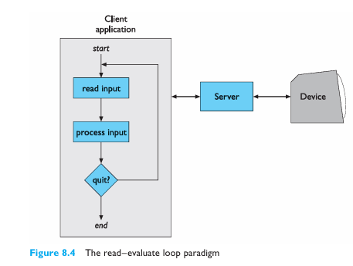
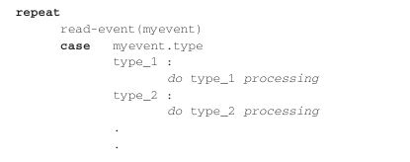
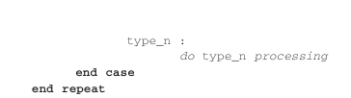
PROGRAMMING THE APPLICATION
The logical flow of the client application is indicated in the left most box of Figure 8.4.
In pseudocode the read–evaluation loop would look like the following:

Slide 12
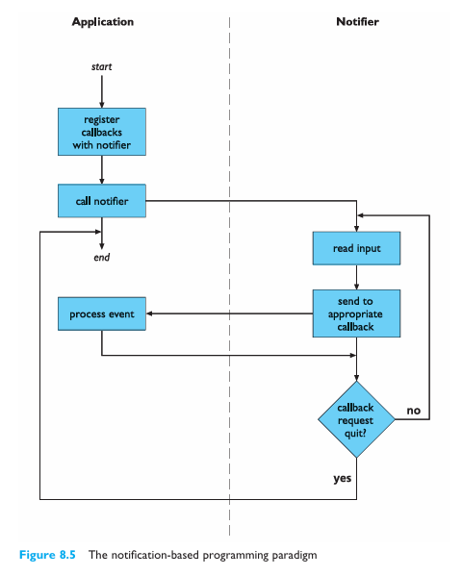
PROGRAMMING THE APPLICATION
The other programming paradigm is notification based, in which the main control loop for the event processing does not reside within the application.
Instead, a centralized notifier receives events from the window system and filters them to the application program in a way declared by the program (see Figure 8.5).
The application program informs the notifier what events are of interest to it, and for each event declares one of its own procedures as a callback before turning control over to the notifier.
When the notifier receives an event from the window system, it sees if that event was identified by the application program and, if so, passes the event and control over to the callback procedure that was registered for the event.
After processing, the callback procedure returns control to the notifier, either telling it to continue receiving events or requesting termination.

Slide 13
USING TOOLKITS
A key feature of WIMP interfaces from the user’s perspective is that input and output behaviors are intrinsically linked to independent entities on the display screen.
This creates the illusion that the entities on the screen are the objects of interest interaction objects we have called them and that is necessary for the action world of a direct manipulation interface. A classic example is the mouse as a pointing device.
The input coming from the hardware device is separate from the output of the mouse cursor on the display screen.
However, since the visual movement of the screen cursor is linked with the physical movement of the mouse device, the user feels as if he is actually moving the visual cursor.
Even though input and output are actually separate, the illusion causes the user to treat them as one; indeed, both the visual cursor and the physical device are referred to simply as ‘the mouse’.
In situations where this link is broken, it is easy to see the user’s frustration.

Slide 14
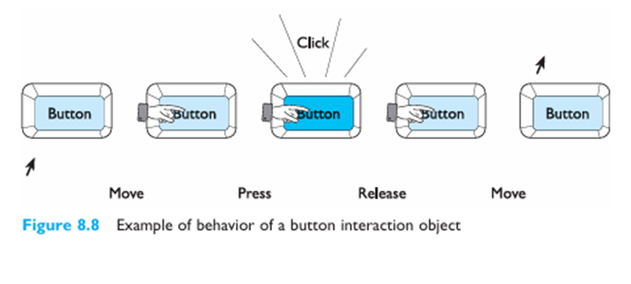
USING TOOLKITS
In Figure 8.8, we show an example of how input and output are combined for interaction with a button object.
As the user moves the mouse cursor over the button, it changes to a finger to suggest that the user can push it.
Pressing the mouse button down causes the button to be highlighted and might even make an audible click like the keys on some keyboards, providing immediate feedback that the button has been pushed.
Releasing the mouse button unhighlights the button and moving the mouse off the button changes the cursor to its initial shape, indicating that the user is no longer over the active area of the button.

Slide 15
USER INTERFACE MANAGEMENT SYSTEMS
Despite the availability of toolkits and the valuable abstraction they provide programmers, there are still significant hurdles to overcome in the specification, design and implementation of interactive systems.
Toolkits provide only a limited range of interaction objects, limiting the kinds of interactive behavior allowed between user and system.
Toolkits are expensive to create and are still very difficult to use by non-programmers.
Even experienced programmers will have difficulty using them to produce an interface that is predictably usable.
There is a need for additional support for programmers in the design and use of toolkits to overcome their deficiencies.
The set of programming and design techniques which are supposed to add another level of services for interactive system design beyond the toolkit level are user interface management systems, or UIMS for short.

Slide 16
USER INTERFACE MANAGEMENT SYSTEMS
The term UIMS is used quite widely in both industrial and academic circles and has come to represent a variety of topics.
The main concerns of a UIMS, for our purposes, are:
A conceptual architecture for the structure of an interactive system which concentrates on a separation between application semantics and presentation;
Techniques for implementing a separated application and presentation whilst preserving the intended connection between them;
Support techniques for managing, implementing and evaluating a run-time interactive environment.

Slide 17
UIMS as a conceptual architecture
A major issue in this area of research is one of separation between the semantics of the application and the interface provided for the user to make use of that semantics.
There are many good arguments to support this separation of concerns:
Portability To allow the same application to be used on different systems it is best to consider its development separate from its device-dependent interface.
Reusability Separation increases the likelihood that components can be reused in order to cut development costs.
Multiple interfaces To enhance the interactive flexibility of an application, several different interfaces can be developed to access the same functionality.
Customization The user interface can be customized by both the designer and the user to increase its effectiveness without having to alter the underlying application.

Slide 18
UIMS as a conceptual architecture
The first conceptual architecture of what constituted a UIMS was formulated at a workshop in 1985 at Seeheim.
The logical components of a UIMS were identified as:
Presentation The component responsible for the appearance of the interface, including what output and input is available to the user.
Dialog control The component which regulates the communication between the presentation and the application.
Application interface The view of the application semantics that is provided as the interface.

Slide 19
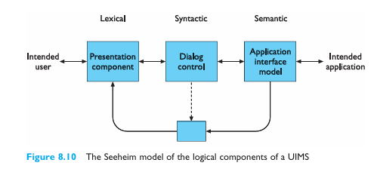
UIMS as a conceptual architecture
Figure 8.10 presents a graphical interpretation of the Seeheim model.
We have included both application and user in Figure 8.10 to place the UIMS model more in the context of the interactive system .
The application and the user are not explicit in the Seeheim model because it was intended only to model the components of a UIMS and not the entire interactive system.
One of the main problems with the Seeheim model is that, whereas it served well as a post hoc rationalization of how a UIMS was built up to 1985, it did not provide any real direction for how future UIMS should be structured.

Slide 20
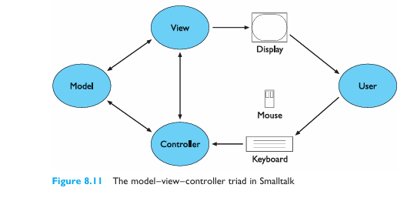
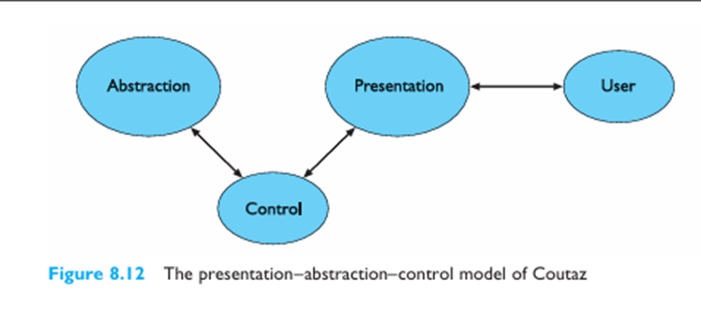
UIMS as a conceptual architecture
Within Smalltalk, the link between application semantics and presentation can be built up in units by means of the MVC triad.
The model represents the application semantics; the view manages the graphical and/or textual output of the application; and the controller manages the input.
The basic behavior of models, views and controllers has been embodied in general Smalltalk object classes, which can be inherited by instances and suitably modified.
Smalltalk, like many other window toolkits, prescribes its own look and feel on input and output, so the generic view and controller classes

Slide 21
UIMS as a conceptual architecture
Another so-called multi-agent architecture for interactive systems is the presentation–abstraction–control PAC model suggested by Coutaz.
PAC is based on a collection of triads also: with application semantics represented by the abstraction component; input and output combined in one presentation component; and an explicit control component to manage the dialog and correspondence between application and presentation (see Figure 8.12).
There are three important differences between PAC and MVC.
First, PAC groups input and output together, whereas MVC separates them.
Secondly, PAC explicitly includes a Control component responsible for ensuring synchronization between Presentation and Abstraction layers. This built-in mechanism ensures consistency and coordination between the UI and underlying data.
MVC, on the other hand, does not explicitly designate a component for maintaining this synchronization. Instead, the responsibility is left to the developer, who must decide how to keep the Model (data) and View (UI) in sync, often through the Controller or via observer patterns.

Slide 22
UIMS as a conceptual architecture
PAC is less dependent on specific implementation details and can be applied in various ways without being restricted to a particular programming framework or language.
In contrast, MVC is often tied to specific UI frameworks (e.g., React, Angular, Spring MVC) and typically follows predefined conventions for implementation.
While PAC is not strictly object-oriented, it is highly conducive to object-oriented design, making it a natural fit for modern software development practices.
MVC also works well with object-oriented programming but is often implemented using event-driven or procedural approaches in some frameworks.
PAC is more of a conceptual architecture than MVC because it is less implementation dependent.
PAC explicitly isolates the Control component, making it responsible for communication and coordination between Presentation and Abstraction.
This structured separation enhances modularity and makes the system more scalable.
MVC, on the other hand, does not explicitly separate control in the same way, leaving developers to manage dependencies between the Model, View, and Controller.

